Slide 1
腔耦合改变g
查辰

Slide 2
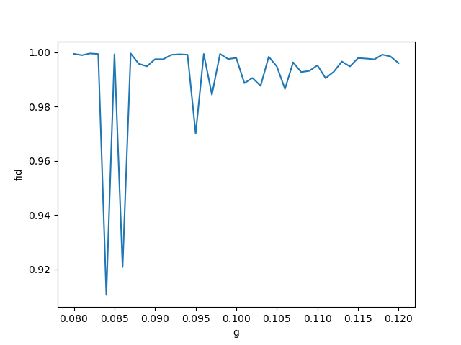
gt = np.linspace(0.08,0.12,41)*2*np.pi

Slide 3
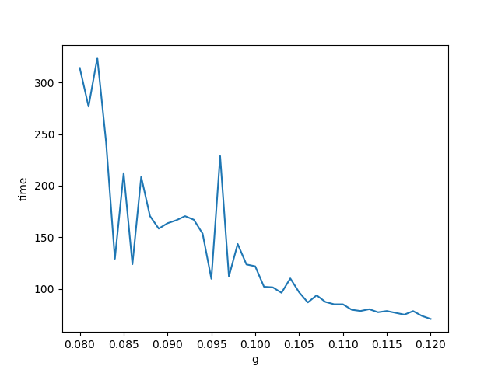

Slide 4
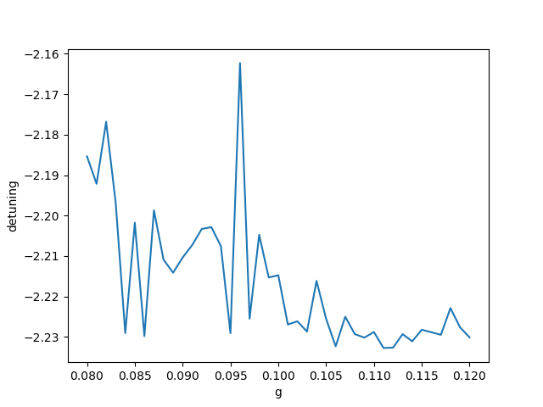

Slide 5
文件

